Slide 1

Movie Rental data analysis
Project-1(MySQL)

Slide 2
INDEX
Introduction
Tasks
Conclusion
1
2
3

Slide 3
Introduction:-
MovieOnRent is a chain of movie rental stores opening in a certain country. It has a vast collection of movies in DVD and Blu-ray disk formats.
The management of the company wants to analyze what kind of movies are most often ranted.
Which genre they belong to and which actors appeared in them. It will help the management stock up inventory as per audience preferences to improve business.
To begin with the management has asked Luna a data analyst to answer certain questions by carrying out the upcoming tasks.

Slide 4
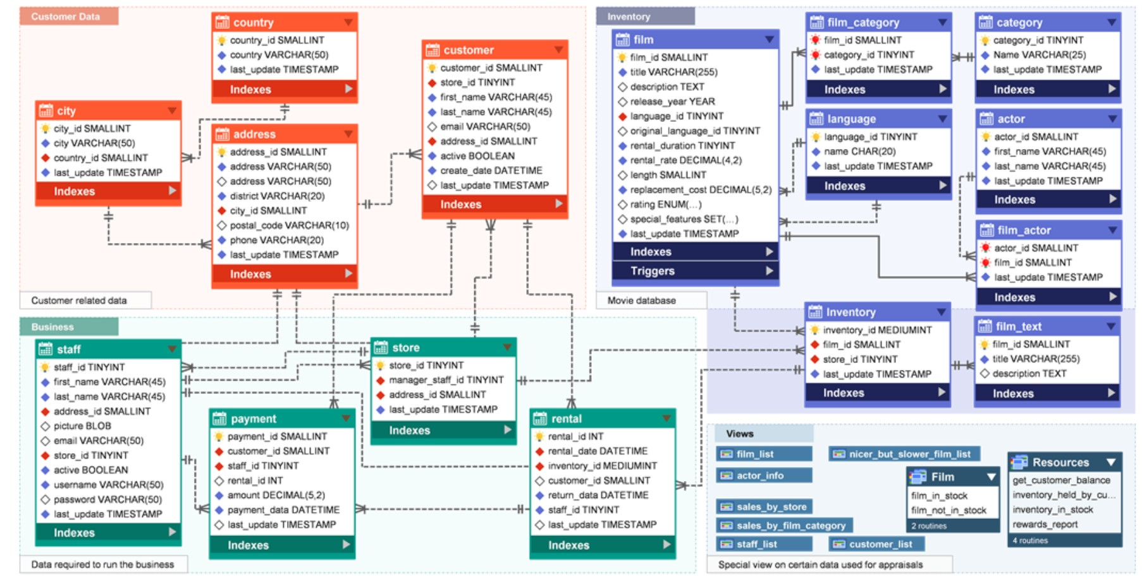
Sakila database schema diagram (er diagram)

Slide 5



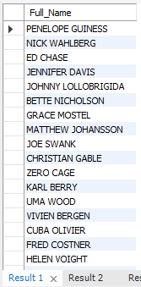
tASKS
Task-1:-Display the full names of actors available in the database
In this task the first name and last name are two different columns. So, we need to join them and display them as a single name.
For this, we used ‘concat’ method to connect two columns together.
We got a total of 200 actor names in this list.
Task-1.csv

Slide 6
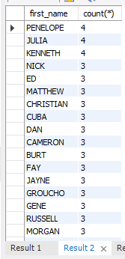
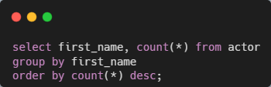
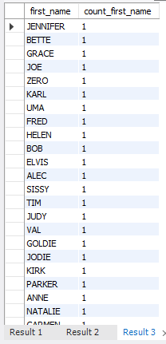
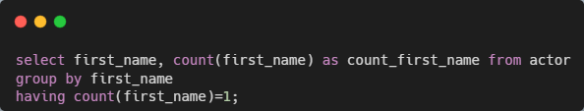
Task 2.1:- Display the number of times each first name appears in database.
Task-2.2:- What is the count of actors that have unique first name in the database. Display the first name of all these actors
In task 2.1, we got a total of 128 rows in output.
PENELOPE, JULIA, and KENNETH are the most repeated names in the database which is around 4 times.
In task 2.2, we got a total of 76 unique names which is repeated only once.
Task-2.1.csv
Task-2.2.csv

Slide 7
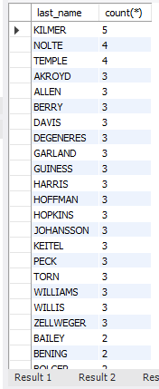
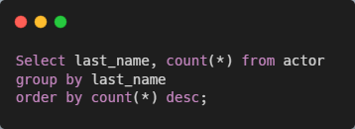
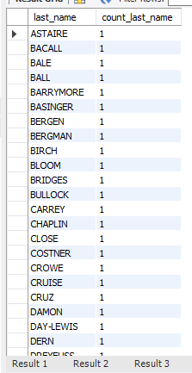
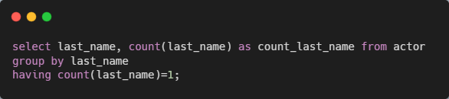
Task-3:-Display the number of times each last name appears in the database
Task-3.2:-Display all unique last names in the database.
In Task 3.1, we got a total of 121 rows in output.
The KILMER is the last_name which is repeated around 5 times.
Task-3.csv
In task 3.2 we got a total of 66 rows in the output
Each row contains the unique last name which is repeated only once in the dataset.
Task-3.2.csv

Slide 8
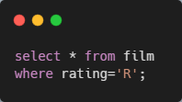
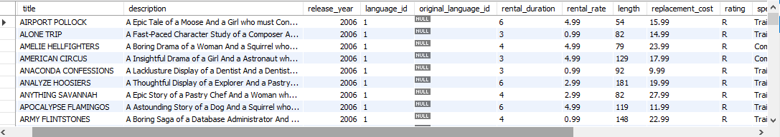
Task-4:-Display the list of records for the movies with the rating ‘R’
In task 4, we got a total of 195 records with the ratings ‘R’
This is the restricted movies which is not suitable for underage customers.
For filtering the data we use where clause.
Task-4.csv

Slide 9
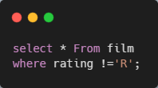
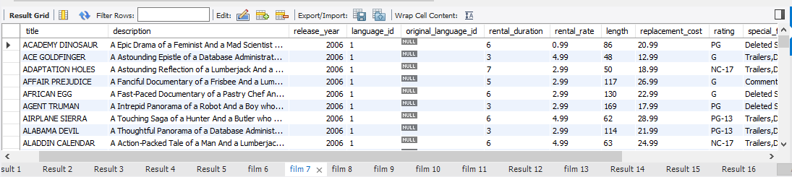
Task-4.2:- Display the list of the movies that are not rated ‘R’
In Task 4.2, we got a total of 805 records in the store which is not rated ‘R’.
This is the other category record that can anyone use.
Task-4.2.csv

Slide 10
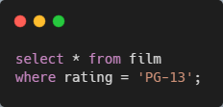
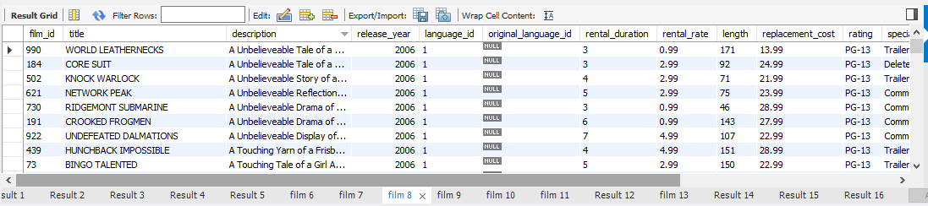
Task-4.3:- Display the list of records for the movie that are suitable for audience below 13 years of age
In Task 4.3, we got a total of 223 records which is suitable for below 13 customers.
This movie records has PG-13 ratings (Parental Guide 13)
Task-4.3.csv

Slide 11
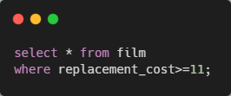
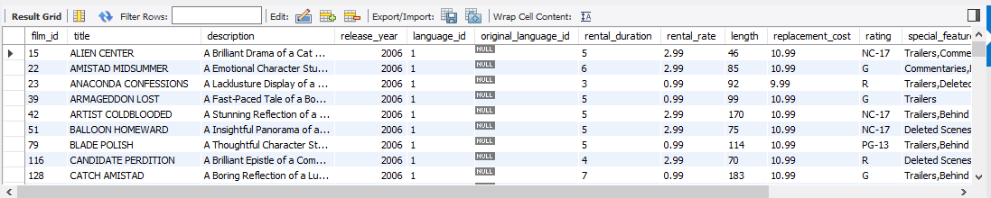
Task-5.1:-Display the list of records for the movies where the replacement cost is up to $11.
In task 5.1, we got a total of 90 results of movies whose replacement cost is up to $11.
This all movies from all categories.
Task-5.csv

Slide 12
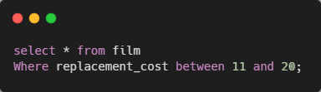
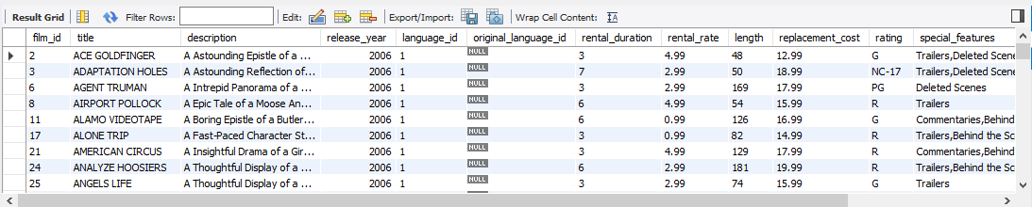
Task-5.2:- Display the list of records for the movies where the replacement cost is between $11 and $20
In task 5.2, we got a total of 424 results of movies whose replacement cost lies between $11 to $20.
For this task we use the ‘between’ function to filter the dataset.
Task-5.2.csv

Slide 13
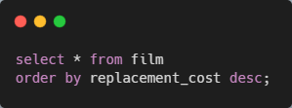
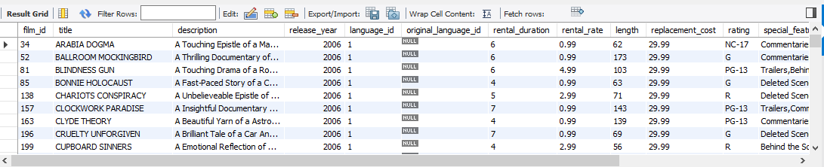
Task-5.3:-Display the list of records for the all movies in descending order of their replacement cost
In task 5.3, we found a total of 1000 rows.
There are 49 movies whose Replacement Cost is $29.99
Task-5.3.csv

Slide 14
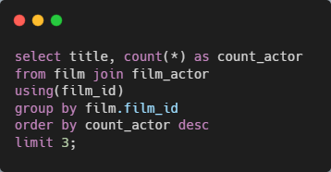
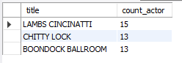
Task-6:-Display the names of the top 3 movies with the greatest number of actors
In this task, we want to display the top 3 movies with the largest number of actors.
Film and film actor are two different tables in the database and we need to join them. For this, we use the ‘JOIN’ method.
We joined both tables using film_id column. Which is common between both tables.
Then, the group the data using film_id. Because we need the counts of actors in output.
After that set the limit for the operation that’s why it shows only the top 3 films.
LAMBS CINCINATTI is the movie with the highest number of actors.
Task-6.csv

Slide 15
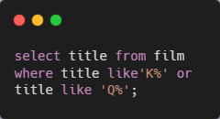
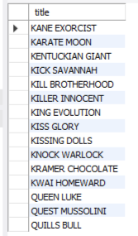
Task-7:-'Music of Queen' and ‘Kris Kristofferson' have seen an unlikely resurgence. As an unintended consequence, films starting with the letters 'K' and 'Q' have also soared in popularity. Display the titles of the movie starting with the letters 'K' and 'Q'
In this task, we want to find the titles of the movies that start with the letters ‘K’ and ‘Q’.
First, we select the titles from the film table.
Then we used the like function to compare and find the titles.
We go a total of 15 movies list whose titles start with the letters ‘K’ and ‘Q’.
Task-7.csv

Slide 16
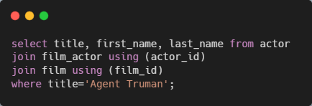
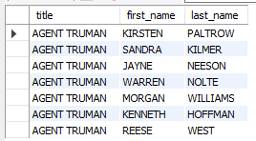
Task-8:-The film 'Agent Truman' has been a great success.-- Display the names of all actors who appeared in this film
we want to find the actors who were cast in the movie ‘Agent Truman’.
For this, we select the title, first name, and lastname from the actor table. But titles and names are in different tables so we need to join them.
The film table and actor table have no common column so, we take a film actor table to join these two tables together.
After joining we set the title for Agent Truman.
In this, we got a total of 7 actors who were cast in the AGENT TRUMAN.
Task-8.csv

Slide 17
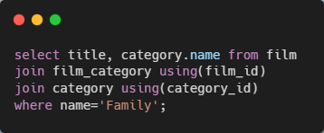
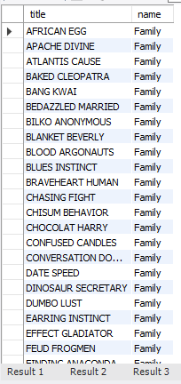
Task-9:-Sales have been lagging among young families, so the management wants to promote family movies. Identify all the movies categorized as family film
For family movies, we need to find the title and category of the film. Both the columns are present in the different tables.
These tables are not directly joined. So, we take the help of the film category table.
These three tables are joined together with common columns present in them. For join we use film_id column and category_id column.
After joining we use the ‘where’ clause for the category name.
We got a total of 69 films in output which is suitable for the Family.
Task-9.csv

Slide 18
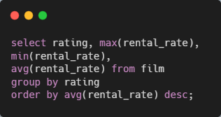
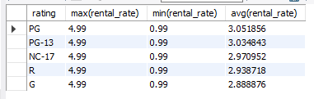
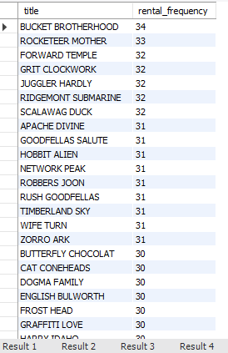
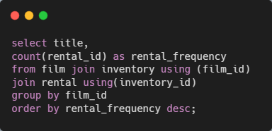
Task-10.1:-Display the maximum, minimum, and average rental rates of movies based on their ratings.
Task-10.2:- Display the movies in descending order of their rental frequencies.
In task 10.1, we take the rating, maximum, minimum, and average of each rating.
After that, PG has the highest ratings.
Task-10.csv
In task 10.2, we got a total of 958 titles in the output.
The BUCKET BROTHERHOOD has the highest rental frequency on the list.
The TRAIN BUNCH has the lowest rental ratings in the list.
Task-10.2.csv

Slide 19
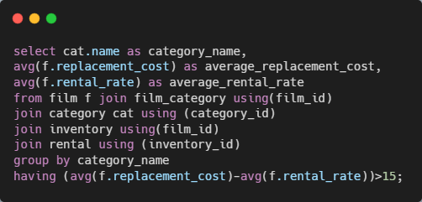
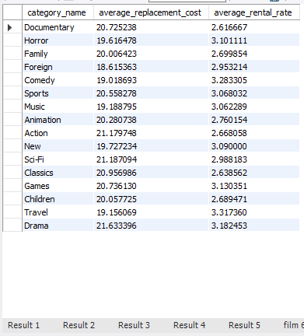
Task-11:- In how many film categories, the difference between the average film replacement cost(disc-DVD/Blue Ray). The average film rental rate is greater than $15
In task 11, we want to find the category–wise difference between the average replacement cost and the average rental rate of the film.
The Drama has the highest replacement cost
The Travel has the highest rental rate.
Task-11.csv

Slide 20
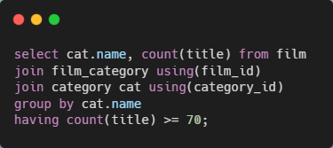
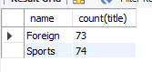
Task-12:- Display the film categories which the number of movies is grater than 70
In task 12, we find the categories whose number of movies is more than 70.
We have two categories that have more than 70 films which are Foreign and Sports.
the Foreign has 73 movies in the category.
The Sports has 74 movies in the category.
Task-12.csv

Slide 21
Conclusion
The sports category has the highest movie count in the dataset.
PG and PG-13 have the highest rental rate in ratings.
The Drama category has the highest replacement cost in the dataset.
As per data, the listed categories are more preferred to rental by customers.
Horror
Comedy
Sports
Music
Games
Travel

Slide 22


THANK YOU
Sanket Bhosale

